Slide 1
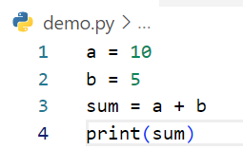
Write step following code below
Step | a | b | sum | output
1 | 10
2 | 10 | 5
3 | 10 | 5 | 15
4 | 10 | 5 | 15 | 15
Example

Slide 2
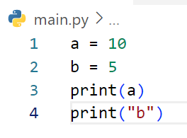
Write step following code below
Step | a | b | output
1 | 10
2 | 10 | 5
3 | 10 | 5 | 10
4 | 10 | 5 | b

Slide 3
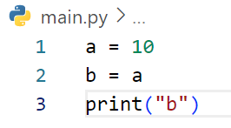
Write step following code below
Step | a | b | output
1 | 10
2 | 10 | a
3 | 10 | a | b

Slide 4
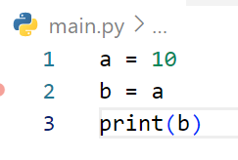
Write step following code below
Step | a | b | output
1 | 10
2 | 10 | a
3 | 10 | a | 10

Slide 5
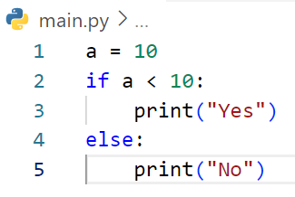
Write step following code below
Step | A | a<10 | output
1 | 10
2 | 10 | False
3 | 10 |  | No

Slide 6
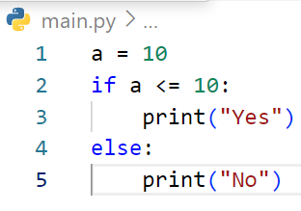
Write step following code below
Step | a | a <= 10 | output
1 | 10
2 | 10 | True
3 | 10 |  | Yes

Slide 7
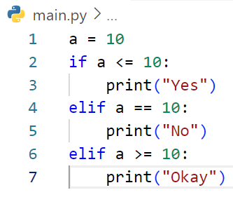
Write step following code below
Step | A | A<=10 | output
1 | 10
2 | 10 | True
3 | 10 |  | Yes

Slide 8
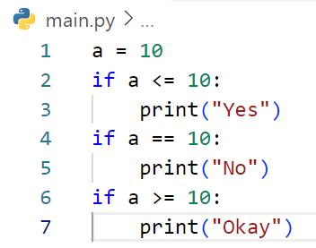
Write step following code below
Step | a | a<=10 | a==10 | a>=10 | output
1 | 10
2 | 10 | True
3 | 10 |  |  |  | Yes
4 | 10 |  | True
5 | 10 |  |  |  | No
6 | 10 |  |  | True
7 | 10 |  |  |  | Okay

Slide 9
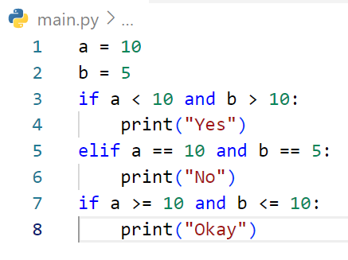
Write step following code below
Step | a | b | A<10 and b>10 | a==10 and b==5 | A ==10 and b<=10 | Output
1 | 10
2 | 10 | 5
3 | 10 | 5 | False
4 | 10 | 5
5 | 10 | 5 |  | True
6 | 10 | 5 |  |  |  | No
7 | 10 | 5 |  |  | True
8 | 10 | 5 |  |  |  | Okay

Slide 10
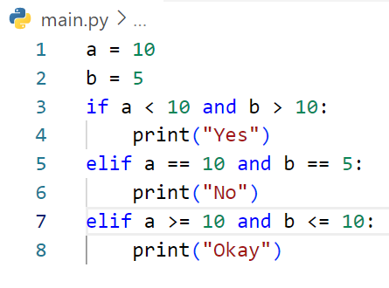
Write step following code below
Step | a | b | a<10 and b>10 | A==10 and b==5 | output
1 | 10
2 | 10 | 5
3 | 10 | 5 | False
4 | 10 | 5
5 | 10 | 5 |  | True
6 | 10 | 5 |  |  | No

Slide 11
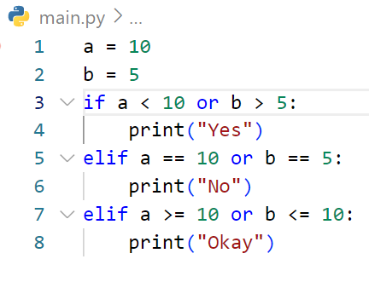
Write step following code below
Step | a | b | a<10 or b>5 | a==10 or b==5 | output
1 | 10
2 | 10 | 5
3 | 10 | 5 | False
4 | 10 | 5
5 | 10 | 5 |  | True
6 | 10 | 5 |  |  | No

Slide 12
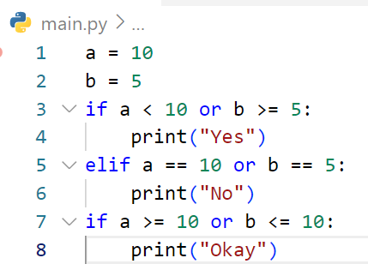
Write step following code below
Step | A | b | a<10 or b>=5 | A>=10 or b<=10 | output
1 | 10
2 | 10 | 5
3 | 10 | 5 | True
4 | 10 | 5 |  |  | Yes
5 | 10 | 5 |  | True
6 | 10 | 5 |  |  | Okay

Slide 13
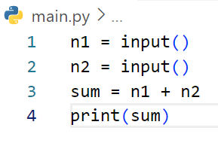
Write step following code below
Step | n1 | n2 | sum | output
1 | 3
2 | 3 | 5
3 | 3 | 5 | error
# If user enter first : 3 and second 5

Slide 14
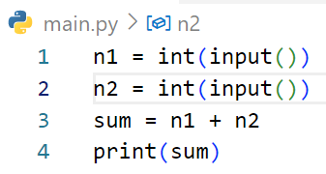
Write step following code below
Step | n1 | n2 | sum | output
1 | 3
2 | 3 | 5
3 | 3 | 5 | 8
4 | 3 | 5 | 8 | 8
# If user enter first : 3 and second 5

Slide 15
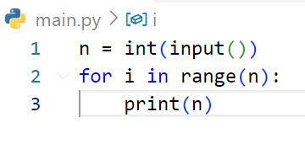
Write step following code below
Step | n | i | output
1 | 3
2 | 3 | 0
3 | 3 |  | 3
4 | 3 | 1
5 | 3 |  | 3
6 | 3 | 2
 |  |  | 3
# If user enter : 3

Slide 16
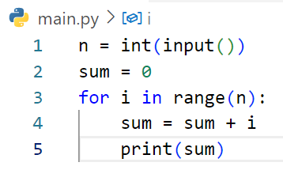
Write step following code below
Step | i | n | sum | output
1 |  | 3
2 |  |  | 0
3 |  | 3 | 0
4 | 0 | 3 | 0
5 | 1 | 3 | 0 | 0
6 | 2 | 3 | 1
7 |  | 3 | 1 | 3
# If user enter : 3

Slide 17
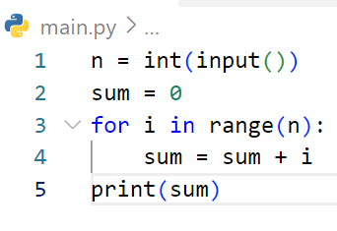
Write step following code below
Step | i | n | sum | output
1 |  | 2
2 |  | 2 | 0
3 | 0 | 2 | 0
4 | 0 | 2 | 0
5 | 1 | 2 | 0 | 0
6 |  | 2 | 0 | 1
# If user enter : 2

Slide 18
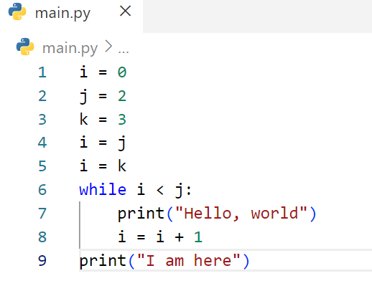
Write step following code below
Step | i | j | k | output

Slide 19
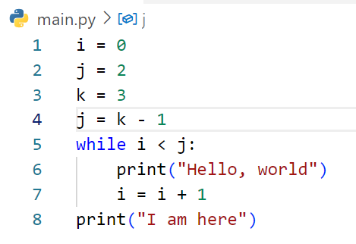
Write step following code below
Step | i | j | k | output

Slide 20
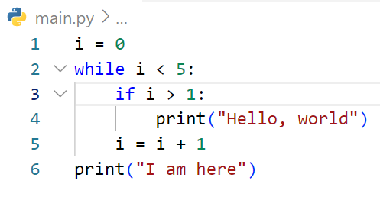
Write step following code below
Step | i | output

Slide 21
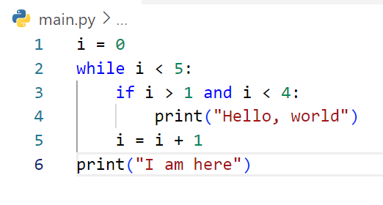
Write step following code below
Step | i | output

Slide 22
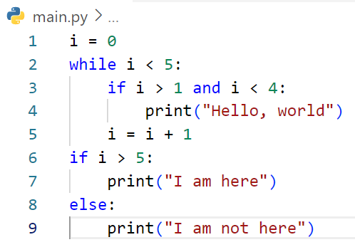
Write step following code below
Step | i | output

Slide 23
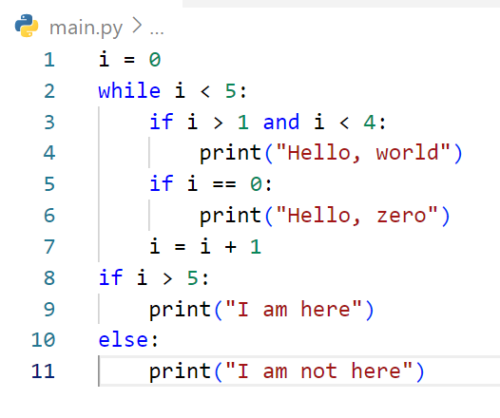
Write step following code below
Step | i | output

Slide 24
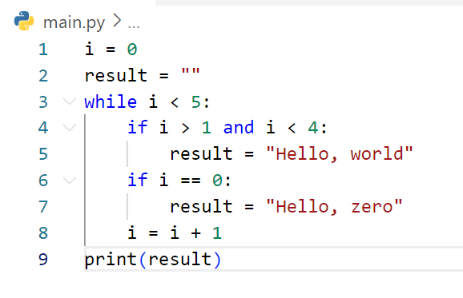
Write step following code below
Step | i | result | output

Slide 25
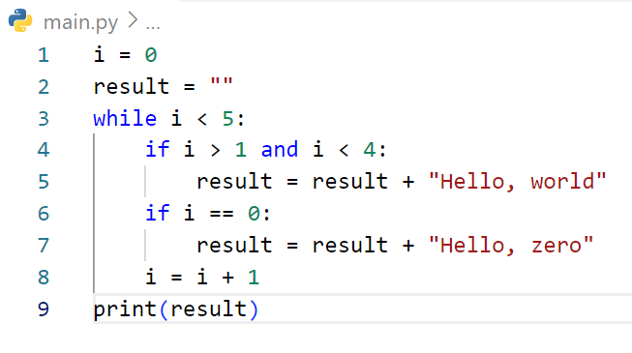
Write step following code below
Step | i | result | output

Slide 26
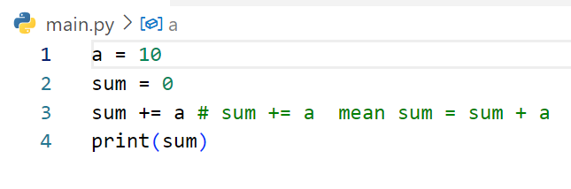
Write step following code below
Step | a | sum | output

Slide 27
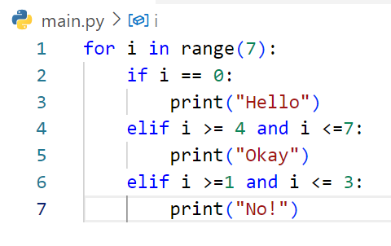
Write step following code below
Step | i | output

Slide 28
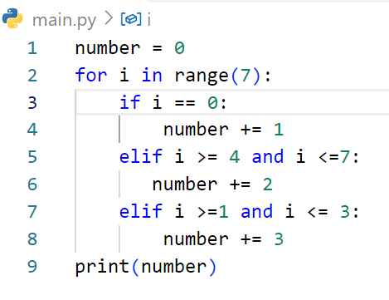
Write step following code below
Step | i | number | output

